Slide 1

CMSC 137
Data Communications and Networking
Lecture Module
11 - Switching

Slide 2
Module 11: Switching
Rozano S. Maniaol
Lecturer

Slide 3
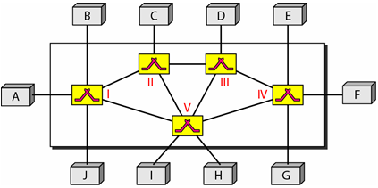
Introduction
Consists of a series of interlinked nodes called switches
Switches are devices capable of creating temporary connections between two or more devices linked to the switch

Slide 4
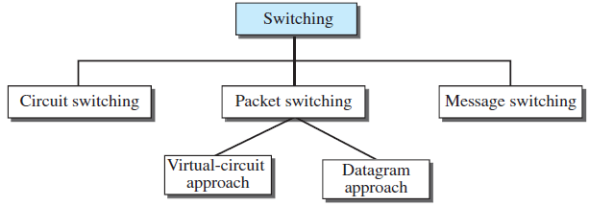
Switched Network

Slide 5
Switching and TCP/IP Layers
Physical Layer
  Circuit switching
Data Link Layer
  Packet switching (virtual approach)
Network Layer
  Packet switching (virtual or datagram approach)
Application Layer
  Message switching

Slide 6
Circuit-Switched Network

Slide 7
Circuit-Switched Network
Set of switches connected by physical links
Connection between two stations is a dedicated path made of one or more links
Only one channel in a link is used
Each link is normally divided into n channels by FDM or TDM
Phases: connection setup, data transfer, connection teardown
Inefficient – dedicated link can be unused
Minimal delay

Slide 8
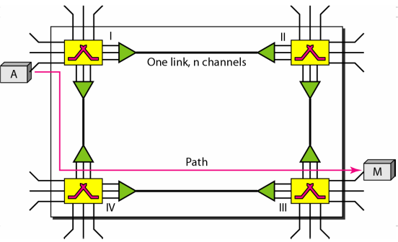
Circuit-Switched Network

Slide 9
Circuit-Switched Network
Takes place at the physical layer
Resources to be used must be reserved
  bandwidth in FDM and time slot in TDM
  Switch buffer
  Switch processing time
  Switch I/O ports
Data transferred are a continuous flow
No addressing involved in the data transfer

Slide 10
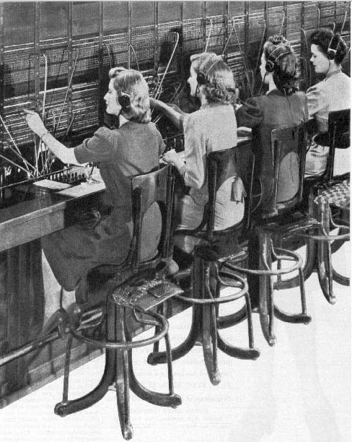
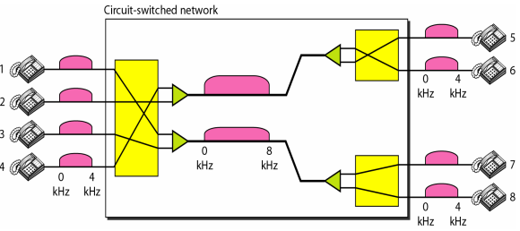
Circuit-Switched Network
Cordboard
http://ourwebhome.com/

Slide 11
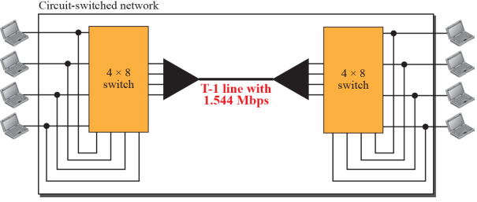
Circuit-Switched Network

Slide 12
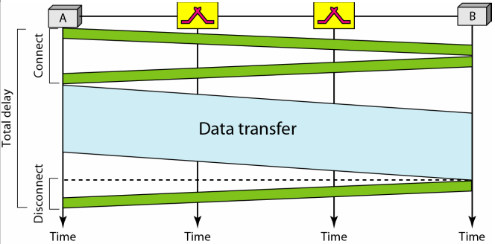
Circuit-Switched Network
Delay is minimal – during data transfer, the data are not delayed at each switch; the resources are allocated for the duration of the connection

Slide 13
Packet Switched Network

Slide 14
Packet Switching
In packet-switched networks, messages are divided into packets: fixed or variable size determined by the network and the governing protocol
No resource allocation for a packet
Resources are allocated on demand; FCFS
2 types: datagram networks and virtual-circuit network

Slide 15
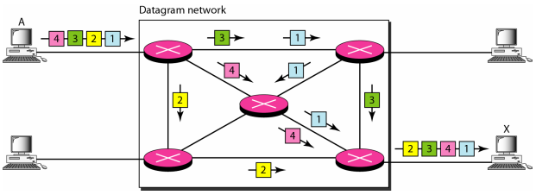
Datagram Network
Each packet is treated independently of all others
Datagram switching done at the network layer
Datagrams may arrive out of order or get lost
Connectionless – no information on state of connection is saved

Slide 16
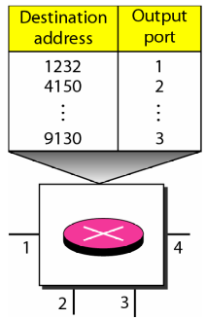
Datagram Network
A switch in a datagram network uses a routing table that is based on the destination address
Routing tables are dynamic and are updated periodically
Header contains address
The destination address in the header of a packet in a datagram network remains the same during the entire journey of the packet

Slide 17
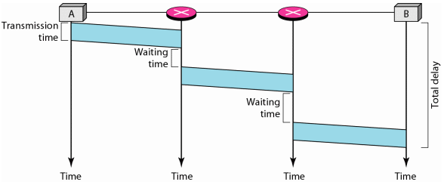
Datagram Network
Efficient – resource are allocated when there are packets to be transferred
More delay – waiting time in switches; also since not all packets in a message travel through the same switches, delay is not uniform

Slide 18
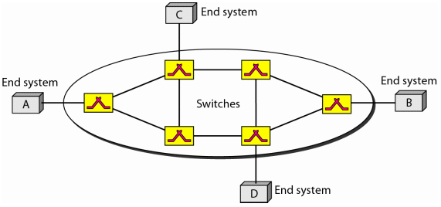
Virtual Circuit Network
Cross between circuit-switched network and datagram network
  With connection setup and teardown phases
  Resources can be allocated during the setup phase or on demand
  Packetized data with address in header (local jurisdiction only)
  Packets follow the same path established
  Implemented in the data link layer

Slide 19
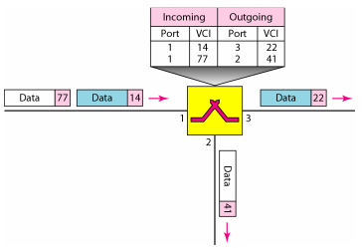
Virtual Circuit Network
A source or a destination needs to have a global address – used to create VCI
Virtual-Circuit Identifier (VCI) – small number that has only switch scope (between two switches)

Slide 20
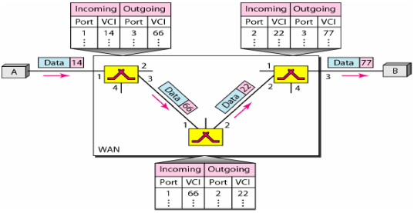
Virtual Circuit Network
Data Transfer Phase – all switches need to have a table entry (in simplest form has 4 columns)

Slide 21
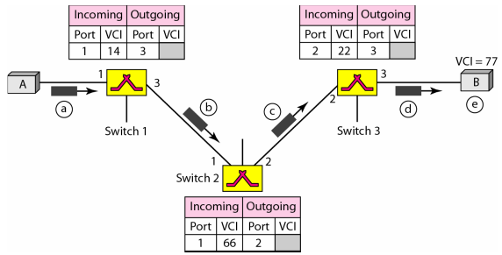
Virtual Circuit Network
In Setup phase, there are 2 required steps:
Setup request – set-up request frame is sent from the source to the destination; switch acts as a packet switch (routing table is different from switching table)

Slide 22
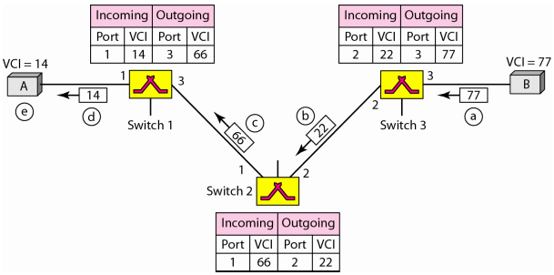
Virtual Circuit Network
Acknowledgment - special frame (acknowledgment frame) completes the entries in the switching tables

Slide 23
Virtual Circuit Network
Efficiency
  All packets belonging to the same source and destination travel the same path but may arrive at the destination with different delays if resource allocation is on demand
  If resource allocation is on demand, the source can check the availability of the sources without actually reserving it

Slide 24
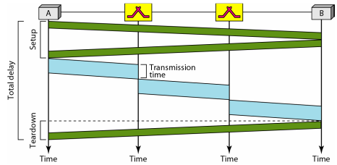
Virtual Circuit Network
Delay – there is one time delay for setup and one time delay for teardown

Slide 25
Structure of a Switch

Slide 26
Structure of a Circuit Switch
Space-division switch – paths in the circuit are separated spatially
  Crossbar (XBar)
  Multistage
Time-division switch – uses TDM
  Time-slot interchange (TSI)
Time- and Space-Division switch combo
  Time-space-time

Slide 27
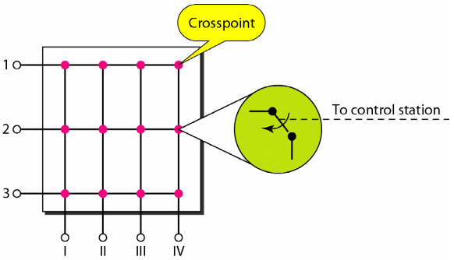
Structure of a Circuit Switch
Crossbar switch – connects n inputs to m outputs in a grid using electronic microswitches (transistors) at each crosspoint

Slide 28
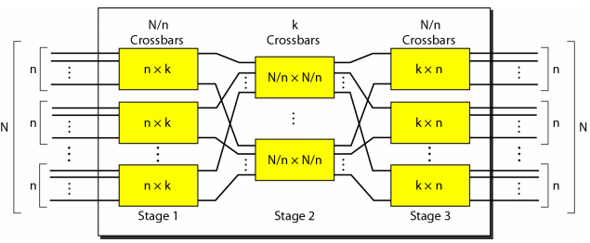
Structure of a Circuit Switch
Multistage switch – combines crossbar switches in several stages

Slide 29
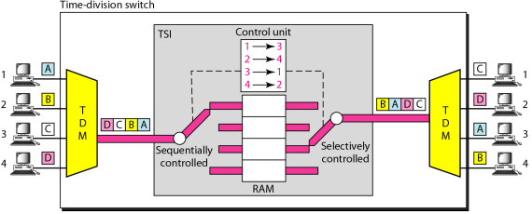
Structure of a Circuit Switch
Time-slot Interchange (TSI) – consists of random access memory (RAM) with several memory locations

Slide 30
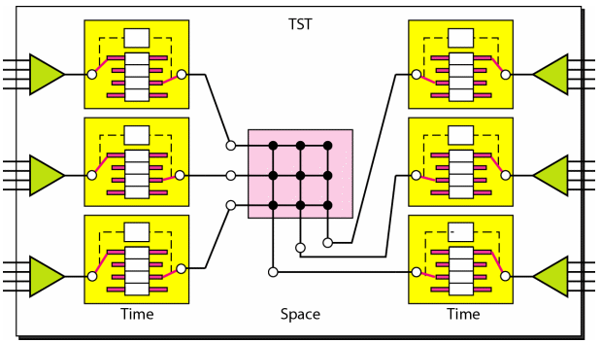
Structure of a Circuit Switch
Time-space-time switch

Slide 31
Structure of a Packet Switch
Four components
  Input ports – performs the physical and data-link functions of the packet switch
  Output ports – performs same function as input ports in reverse order
  Routing processor – perform function of the network layer
  Switching fabric
    Crossbar
    Banyan
    Batcher-Banyan Switch

Slide 32
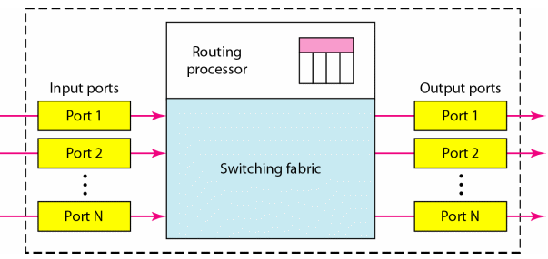
Structure of a Packet Switch

Slide 33
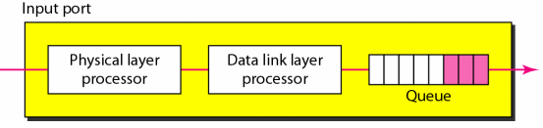
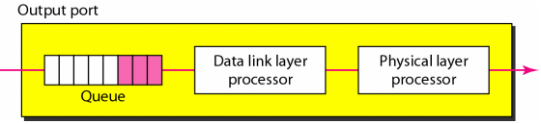
Structure of a Packet Switch

Slide 34
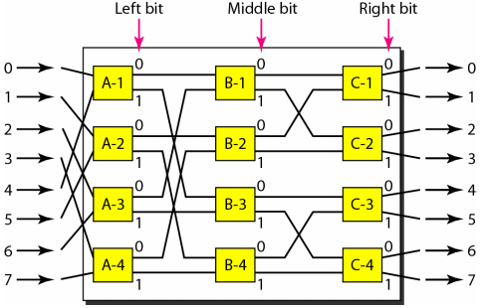
Structure of a Packet Switch
Banyan switch – multistage switch with microswitches at each stage that route the packets based on the output port represented as a binary string

Slide 35
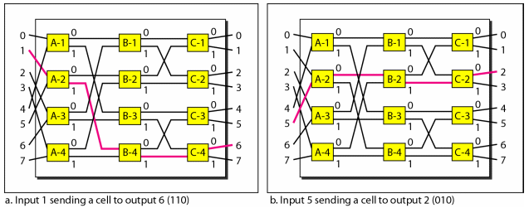
Structure of a Packet Switch
Routing in a Banyan Switch
Problem: Possibility of internal collision even when two packets are not heading for the same output port

Slide 36
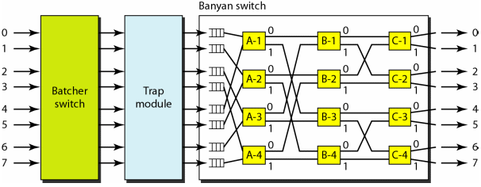
Structure of a Packet Switch
Batcher-Banyan Switch – combination of Banyan switch and a switch designed by K.E. Batcher which sorts incoming packets according to their final destinations

Slide 37
References
Forouzan, B.A. 2013. Data Communications and Networking, 5th Ed. McGraw-Hill, New York.

